Slide 1
Dimensionality Reduction and Unsupervised Learning

Slide 2
Objectives
Describe the differences between supervised and unsupervised learning
Compare and contrast Hierarchical Cluster Analysis (HCA) and k-Means clustering
Conduct a HCA and interpret the output
Tune the number of clusters for k-Means clustering
Select the optimal number of principal components for dimension reduction
Generate predictions using Linear Discriminant Function Analysis (LDA) as a supervised classifier
Tune hyperparameters using GridSearchCV
Evaluate classifier model performance

Slide 3
Supervised Learning vs. Unsupervised Learning
Supervised Learning: clear instruction is provided to predictive models concerning the outcome for which to learn
Unsupervised Learning: descriptive models are used in exploratory analysis to uncover patterns in unlabeled data

Slide 4

Hierarchical Cluster Analysis (HCA)
Measures the Euclidean distance between and among all observations in the data and creates links at the distance in which the two points lie

Slide 5
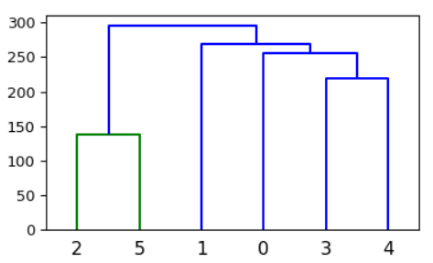
HCA Output - Dendrogram
Allows user to visually identify relationships between/among all observations
Euclidean Distance
Links
Observations

Slide 6
K-Means clustering
Best used when a predetermined k (number) of clusters is known
Two phases:
Assignment
Updating
Notes:
Lantz, B. (2013). Machine learning with R. Packt Publishing Ltd.

Slide 7
K-Means Clustering
Assignment phase
Observations are assigned to the cluster in which they are closest in terms of distance
Updating phase
Cluster centers are adjusted to the average position of points in cluster (i.e., centroids)
If observations fall into another cluster then group centroids need to be recalculated
Cycle continues until no centroid recalculation is necessary

Slide 8
K-Means Clustering
Remember, cluster center locations are generated at random so results can vary from model to model
Thus, building an ensemble of models and taking a summary measure can help us gain confidence in our findings

Slide 9
K-Means Clustering: Improving Confidence in Predictions
Ensemble: Iterating through n models and taking a summary statistic of all models
Mean
Mode…

Slide 10
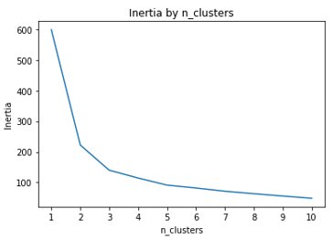
K-Means Clustering: Determining k
Build multiple models with different values for n_clusters
Plot inertia by n_clusters

Slide 11
K-Means Clustering: Tuning n_clusters with nested ensemble
Nested loop:
Outside loop controlling n_clusters
Inside loop iterating over each model n times

Slide 12
Dimensionality Reduction
Too many features:
Increases the probability of multicollinearity and subsequent overfitting of the model
Poor performing models
Expand the complexity of the model and increase the time for model tuning and fitting
Principal Component Analysis (PCA) common method to reduce dimensionality

Slide 13
Principal Component Analysis (PCA)
Creates uncorrelated linear combinations (components) from original features
Together, all components add up to explain 100% of the variance in the data
The first component explains the most variance
Each of the following components explain progressively less variance

Slide 14
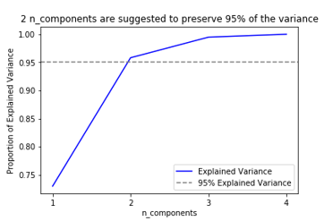
Principal Component Analysis (PCA): Tuning n_components
Set a user-defined threshold for amount of explained variance to keep in the data
Calculate the cumulative sum of each component
See how many components to include in order to reach the threshold

Slide 15
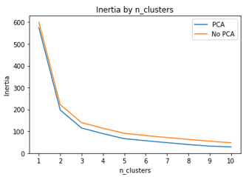
Principal Component Analysis (PCA): Model Performance
Plot inertia by n_clusters before PCA transformation
Plot inertia by n_clusters after PCA transformation
Plot both on the same plot

Slide 16
Supervised Learning with Linear Discriminant Function Analysis (LDA)
LDA is most commonly used for dimension reduction, but can also be used as a supervised classifier
The intent of LDA is to identify the linear boundaries best differentiating groups

Slide 17
Linear Discriminant Function Analysis (LDA)
For supervised learning:
Default hyperparameters
Tuning hyperparameters using GridSearchCV
Tuning hyperparameters using GridSearchCV in pipeline

Slide 18
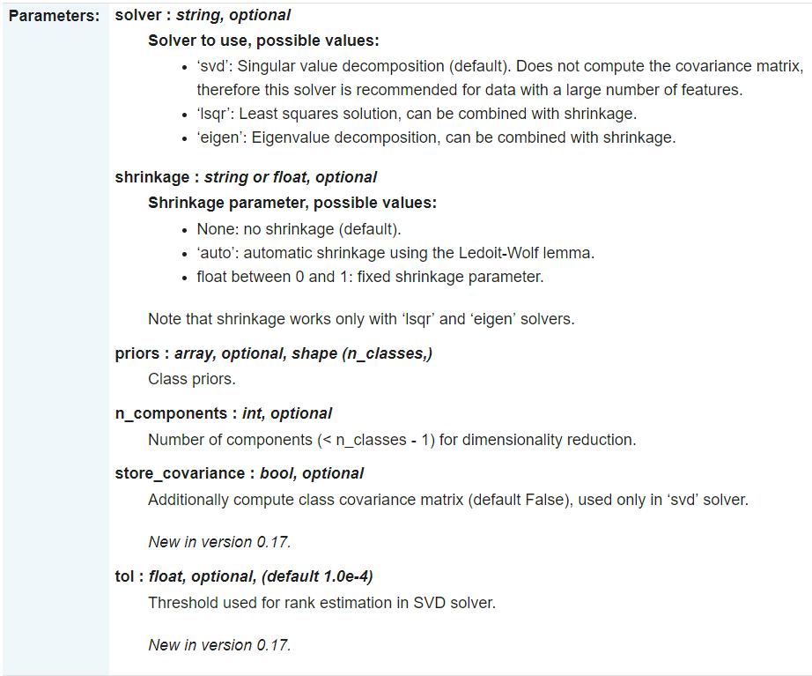
What are hyperparameters?
Settings within an algorithm that are set by the user which influence how the model fits and performs on the data
Listed in documentation

Slide 19
Finding best combination of hyperparameters
Grid search
Builds a model for each combination of hyperparameters
Picks the model that performs best according to a scoring metric
Can be time-consuming for large data sets and/or numerous hyperparameters

Slide 20
Tuning hyperparameters in pipeline
Why use a pipeline?
Assemble several steps while tuning a model
More concise code
Less room for manual error

